Slide 1
Charting the Islands:
Clustering Hawaiian Geographies

Slide 2
Know the communities, know how to serve
Utility companies are facing increased operating costs across the country as they repair or replace old infrastructure, invest in green energy, or encounter demographic shifts in their communities.
But increased monthly bills can be particularly difficult for low-income communities.
Hawaii poses a unique challenge as a diverse island chain, with communities divided both by socioeconomics and exceptional geographical divides (literally, islands).
Which communities are most financially vulnerable? Which communities rely more on certain utilities? Which communities are similar in these respects?

Slide 3
Data Collection and Cleaning
Median household income, household composition, geographies (zip code, county, and state levels) were downloaded from the Census Bureau’s 2017 ACS estimates (Table S1901).
Geolocation data was downloaded from the Hawaiian Statewide GIS Program.
Venue data for each geography was collected from Foursquare.
Zip codes that did not have Censure Bureau data were excluded.
A total of 91 geographies with data were used: 1 state level, 5 counties, 85 zip codes.
A total of 1565 venues were collected within the zip codes.

Slide 4
Data Snapshot
DBSCAN Cluster | KNN Cluster | MHI | Total Households | Family Households | Nonfamily Households | % of State MHI | City | County | Latitude | Longitude | Zip Code
0 | 1 | 91646 | 13080 | 9329 | 3751 | 1.22 | Aiea | Honolulu | 21.40605 | -157.8849 | 96701
0 | 1 | 62500 | 594 | 404 | 190 | 0.83 | Anahola | Kauai | 22.14558 | -159.3856 | 96703
1 | 7 | 51483 | 2578 | 1854 | 724 | 0.69 | Captain Cook | Hawaii | 19.33727 | -155.8376 | 96704
-1 | 8 | 75938 | 761 | 595 | 166 | 1.01 | Eleele | Kauai | 21.89953 | -159.5685 | 96705
-1 | 6 | 98248 | 18988 | 15708 | 3280 | 1.31 | Ewa Beach | Honolulu | 21.34476 | -158.0222 | 96706
-1 | 6 | 99946 | 12889 | 10363 | 2526 | 1.33 | Kapolei | Honolulu | 21.36311 | -158.0822 | 96707
The first two columns represent the clusters assigned to each Zip Code via each cluster analyses (DBSCAN and K-Nearest Neighbors)

Slide 5
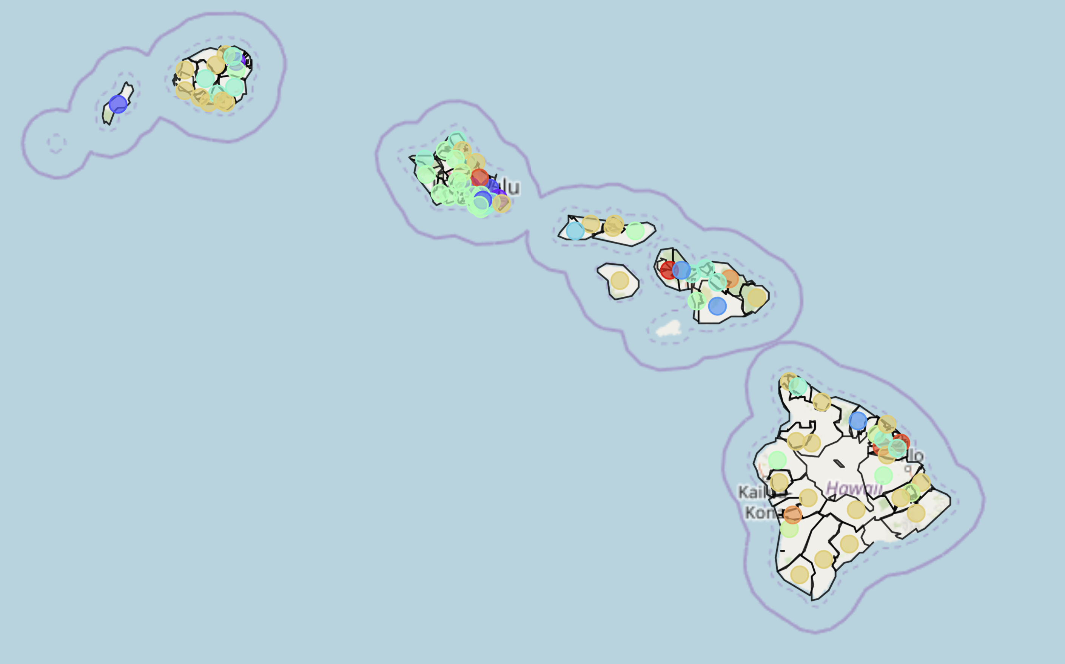
KNN Clusters: Urban vs Rural
All 85 zip codes were grouped into one of 11 clusters.
Urban areas, in light green and light teal, grouped around the major cities and towns (e.g. Honolulu, Kahului, Kona)
More rural areas, in light brown/yellow, grouped around the southern coasts of the Big Island and Kauai.

Slide 6
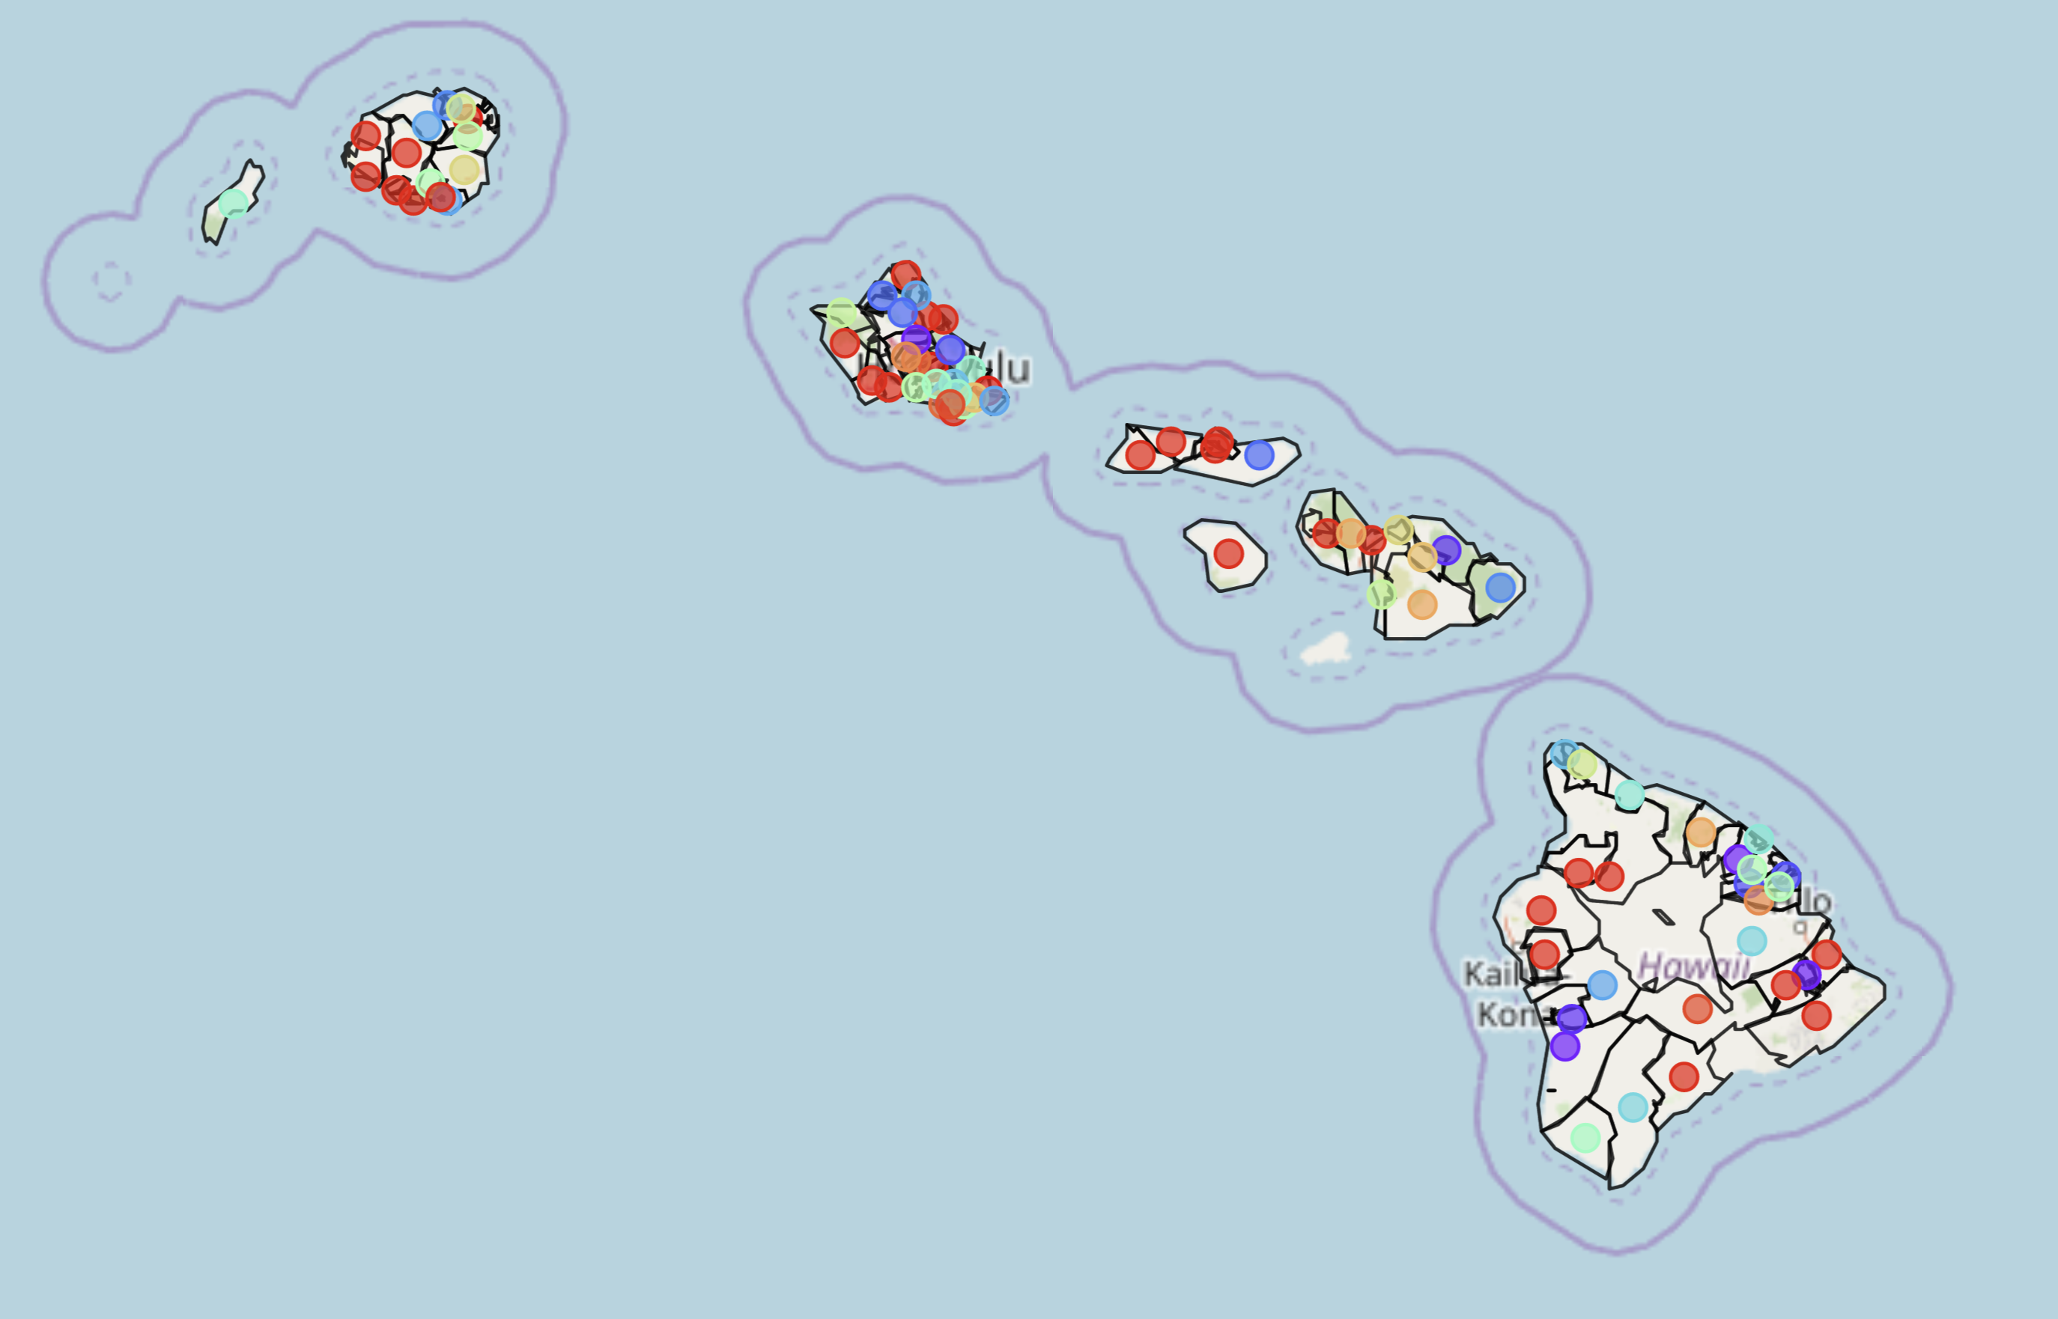
DBSCAN Clusters: Diversity + Complexity
47 zip codes were clustered into 21 clusters. 28 zip codes were deemed outliers.
No hard-fast rule denoting outliers—zip codes could be outlier for any combination of reasons rather than one main factor.
Diverse clusters suggest complex communities across the islands—with many similarities and differences.

Slide 7
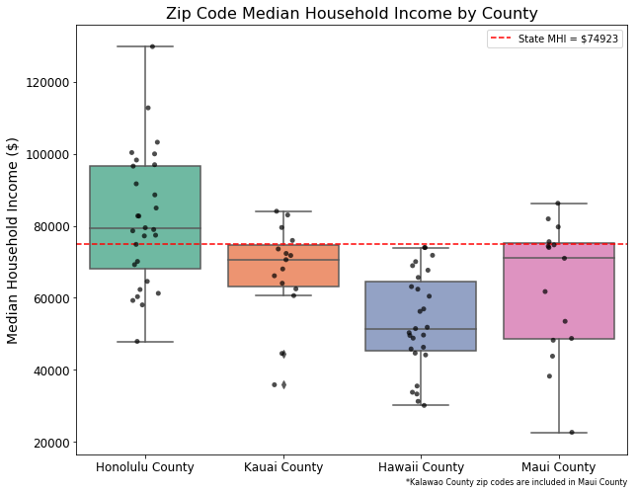
Common Denominator? SES
The KNN Clusters were significantly related to the DBSCAN Clusters (r = -.24, p <0.05)
Likely that cluster overlap was driven by stark SES differences between counties and zip codes.
Oahu is notably wealthier than the other islands, and likely the reason why the state MHI is far higher than the remaining counties’ MHI.

Slide 8
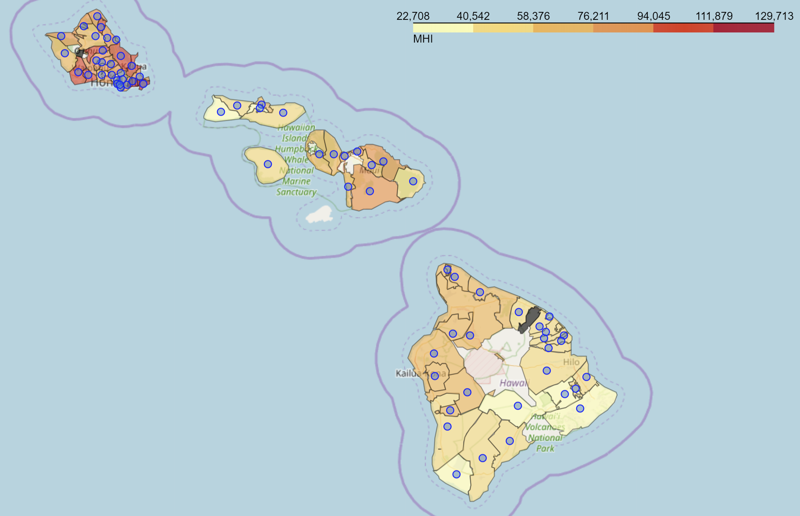
Socioeconomics > Venue Makeup
Wealth, and by extension rural vs urban, differences seem to be a more meaningful way to understand Hawaiian communities than the venues that are in said communities.
Wealth differences between zip codes show an urban to rural and inter-island divide.
Snapshot of map shading zip codes by MHI.

Slide 9
Conclusion:
In lieu of reliable data on the utility draws of respective geographies, utility companies should rely on socioeconomic indicators to make policymaking decisions.
Venues within a community does not appear to be a robust marker for grouping communities in Hawaii.
Communities across the Hawaiian islands are very diverse—attempts to serve communities must be flexible to adapt to their particular needs
Each county has quite different socioeconomic makeup, and zip codes within said counties can vary as well.

